Slide 1
A study of garbage of Garbage collection using convolutional Neural Networks
The main objective is to conduct a comparative study between different object detection models based on their performance on our dataset.
Models are tuned so as to get higher accuracy and better results in the most unlikely conditions.
Further, a Garbage Detection System is introduced to automatically identify and locate the garbage in real-world images and videos.
State-of-the-art image processing and object detection methods incorporated with Deep Learning can help track and analyze the streets using data coming from different sources such as satellite imagery, drone camera, user_x005F_x0002_clicked images CCTV footage, video sequences, etc.
A classifier can be used for the identification of objects.

Slide 2
Introduction
Currently, the world generates 2.01 billion lots of municipal solid waste annually, which is huge damage to the ecological environment. Waste manufacturing will extend by way of 70% if cutting-edge conditions persist. Recycling is becoming an essential section of a sustainable society. However, the whole process of recycling needs a big hidden cost, which is caused through selection, classification, and processing of the recycled materials. Even though shoppers are inclined to do their own garbage sorting nowadays in many countries, they may be burdened about how to decide the correct category of the rubbish when disposing of a massive variety of materials. Finding an computerized way to do the recycling is now of magnificent value to an industrial and information-based society, which has not solely environmental results but also recommended financial effects.

Slide 3
ABSTRACT
Waste management is a pressing global concern as the world grapples with mounting piles of garbage. This project aims to address this issue through the development of a Smart Garbage Classification System. By enhancing the efficiency and accuracy of waste sorting, this system contributes to reducing environmental pollution and promoting recycling efforts. The project underscores the importance of sustainable waste management, not only for a cleaner environment but also for a healthier and more sustainable future. Different types of waste types warrant different management techniques and hence, proper waste segregation according to its types is essential to facilitate proper recycling. Current existing segregation method still relies on manual hand-picking process. In this paper, a method; based on deep learning is used to classify wastes using their images into six different waste types (glass, metal, paper, plastic, cardboard and trash) has been proposed. Here, Convolutional Neural Network (CNN) model has been used for classification of waste.

Slide 4
Literature Survey
Sno | Paper id | Year of publication | Author | Comments
1. | 1108–1113 | 2018 | M. Anjum and M. S. Umar | Deals with a deep CNN architecture called GarbConvNet (GCN), trained on the Garbage Image Dataset (GIDset).
2. | 940–945 | 2016 | G. Mittal, K. B. Yagnik | Introduces an Android app named SpotGarbage to detect and locate garbage in the user-clicked geo-tagged images.
3. | 422–431 | 2019 | V. Ruiz, A. S´anchez | Compares several standard CNN architectures namely VGG, Inception, and ResNet by training them on the Trashnet dataset for the classification of multiple types of waste items.
4. | 505–509 | 2016 | A. Singh, P. Aggarwal | An IOT-based technique is used here to obtain real-time data from the dustbins using infrared sensors.

Slide 5
Existing System
Research on garbage classification, created the public TrashNet Dataset. There are 2,527 images separated into six categories: 403 cardboard, 501 glass, 410 metal, 594 paper, 482 plastic, and 137 other waste materials. Yang and Thung used a method called support vector machine (SVM) to perform early trials.
Used an algorithm called random forest (RF) to classify these images and
The RF algorithm is a classifier that trains and predicts samples through multiple decision trees, each of which plays a role in the final decision of the predicting outcomes.
In the era of big data and samples, RF training can highly parallelize data, which improve training speed.
Later, experiments are done using another algorithm called XGBoost algorithm. is an

Slide 6
Disadvantages Existing System
Traditional machine learning methods described above have been around for a long time and have achieved good results in the field of image processing. However, these methods usually consist of several independent processes, so they require a great amount of storage space for intermediate results, causing cumbersome and unintelligent implementation procedures.
Accuracy improvements are needed.

Slide 7
Proposed Methodology
Image processing and object detection methods incorporated with Deep Learning can help track and analyze the streets using data coming from different sources. The main objective of this research is to conduct a comparative study between different object detection models based on their performance on our dataset.
Models are tuned so as to get higher accuracy and better results in the most unlikely conditions. Further, a Garbage Detection System is introduced to automatically identify and locate the garbage in real-world images and videos.
Present work incorporates the use of five different object detection models for implementing real-time Garbage Detection System. The first four models have been taken for the implementation from TensorFlow . Detection architecture used in our work was pre-trained on the COCO dataset and is available on the UCI-ML repository.

Slide 8
Advantages of Proposed Methodology
The main advantage of this research is to conduct a comparative study between different object detection models based on their performance on our dataset.
Models are tuned so as to get higher accuracy and better results in the most unlikely conditions.
Garbage Detection System is introduced to automatically identify and locate the garbage in real-world images.

Slide 9
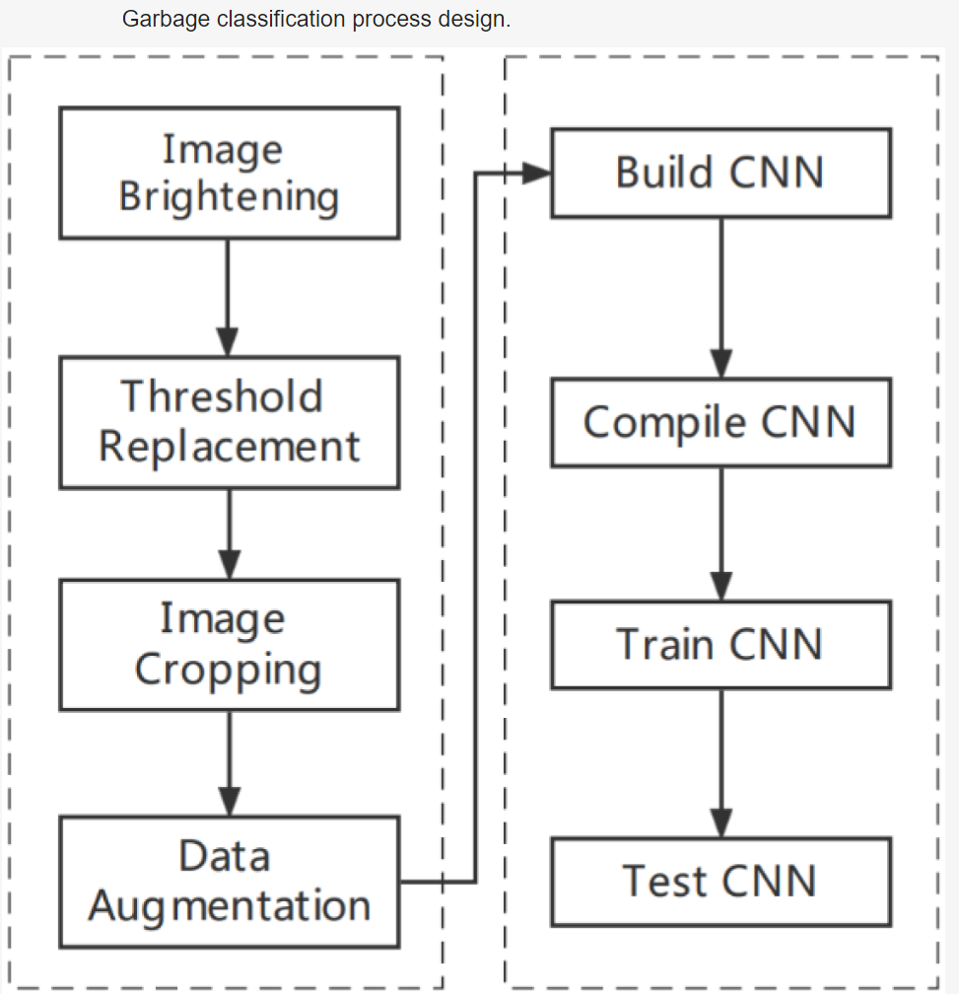
Architectural Diagram

Slide 10
Faster R-CNN ResNet-101:
The R-CNN family consists mainly of three models: R-CNN, Fast R-CNN and Faster RCNN. The primary purpose of the R-CNN model is to extract multiple regions from a given image using a selective search algorithm and then locate an object in each of those regions if present. However, for the task of object detection, R-CNN becomes very sluggish due to several steps involved. To extract features from the regions, the Fast R-CNN model uses a single CNN network, classifies them into different classes and returns bounding boxes. This model is faster than R-CNN because it performs all three tasks concurrently.

Slide 11
Requirement specification
Software Requirements
Operating System : Windows 7
Programming Language : JAVA
Java Version : JDK 1.6 & Above
Database : MYSQL
Http Server : Tomcat
Design : HTML, JSP, JavaScript
Server side script : Java Server Pages
Back End : My Sql
Hardware Requirements
Processor : Intel I5
Speed : 1Ghz
RAM : 1GB(min)
Hard Disk : 300GB

Slide 12
Conclusion
In conclusion a Garbage Detection System that can automatically detect and locate the garbage areas in the images as well as videos. Available approaches were examined and novel system was developed for the purpose. On evaluation of the results of these models for the proposed system, it was noted that YOLOv5M has a promising precision value and provides reliable and accurate predictions. Also, this version significantly outperformed the previous versions of YOLO with substantial improvisation in terms of speed, model size and performance. Although our system predicts garbage in images as well as live video streams in real-time, further reductions in predictive time continues to be a challenge.

Slide 13
References
H. Begur, M. Dhawade, N. Gaur, P. Dureja, J. Gao, M. Mahmoud, J. Huang, S. Chen, and X. Ding, “An edge-based smart mobile service system for illegal dumping detection and monitoring in san jose,” in 2017 IEEE SmartWorld, Ubiquitous Intelligence & Computing, Advanced & Trusted Computed, Scalable Computing & Communications, Cloud & Big Data Computing, Internet of People and Smart City Innovation (SmartWorld/SCALCOM/UIC/ATC/CBDCom/IOP/SCI). IEEE, 2017,
pp. 1–6.
Y. Wang and X. Zhang, “Autonomous garbage detection for intelligent urban management,” in MATEC Web of Conferences, vol. 232. EDP Sciences, 2018, p. 01056.
A. VJ, K. Balakrishnan, T. Rosmi, K. S. Krishna, S. Sreejith, and T. Subha, “Automatic waste segregator and monitoring system,” Journal of Microcontroller Engineering and Applications, 2016.
A. Singh, P. Aggarwal, and R. Arora, “Iot based waste collection system using infrared sensors,” in 2016 5th International Conference on Reliability, Infocom Technologies and Optimization (Trends and Future Directions)(ICRITO). IEEE, 2016, pp. 505–509.

Slide 14
Queries ?

Slide 15
Thank you

